Slide 1


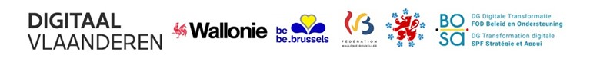
Inter Communautary Exchange Group (ICEG)

Slide 2

ICEG ?
Coordination for intra-Belgian digital strategy
Collaboration agreement between:
The Federal Government Staat
Flemish Community & Flemish Region
German speaking Community
French speaking Community
Walloon Region
Brussels Capital Region
French Community Commission
Common Community Commission

Slide 3
Timeline
2001 first
collaboration agreement
Creation technical workgroup
10 members
2006 strategic committee
Representation from involved administrations and cabinets ministers or secretaries of state with responsibility on
2013 new
collaboration agreement
Continuation of the strategic committee
Concrete initiatives
One or more representatives from all parties
Execution of the collaboration agreement
e-government

Slide 4

Approach
Exchange of good practices
Coordinated approach international benchmark studies
Agree on interfederal collaboration agreements
Informal consultation
Workgroup common data standards
Organize and optimize Interoperability
Coordination of the implementation of EU regulations

Slide 5

ICEG in practice
Three to four meetings a year
Secretariat by FPS BOSA – DG Simplification and Digitalisation
Contact: Frank Leyman frank.leyman@bosa.fgov.be

Slide 6

ICEG in practice
Present president:
François Du Mortier
(Paradigm)
Presidency on a yearly basis

Slide 7
ICEG in practice
Present members:
FPS BOSA – DG Simplification and Digitalisation
Dienst Administratieve Vereenvoudiging (DAV)
Digitaal Vlaanderen
V-ICT-OR
e-Wallonie Bruxelles Simplification (eWBS)
Intercommunale de Mutualisation Informatique et Organisationnelle (iMio)
Centrum voor Informatica voor het Brusselse Gewest (CIBG)
Ministerium der Deutschsprachigen Gemeinschaft
Kabinet Mathieu Michel
Kabinet Bernard Clerfayt

Slide 8
Data standardization under ICEG

Slide 9
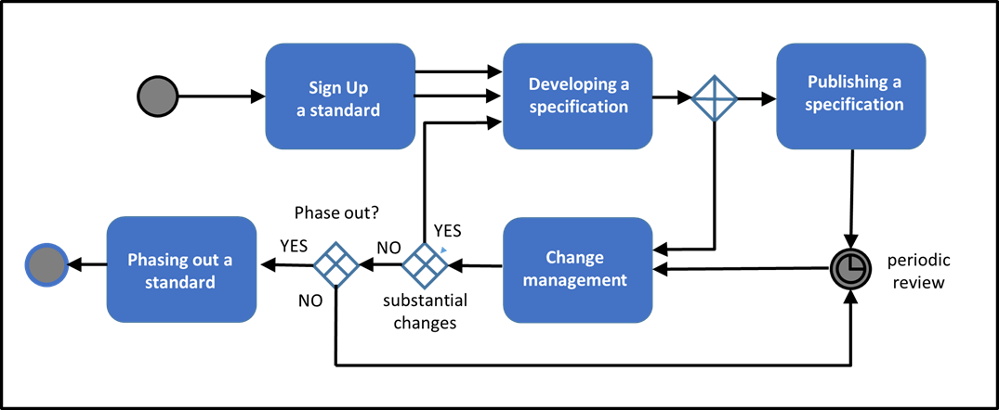
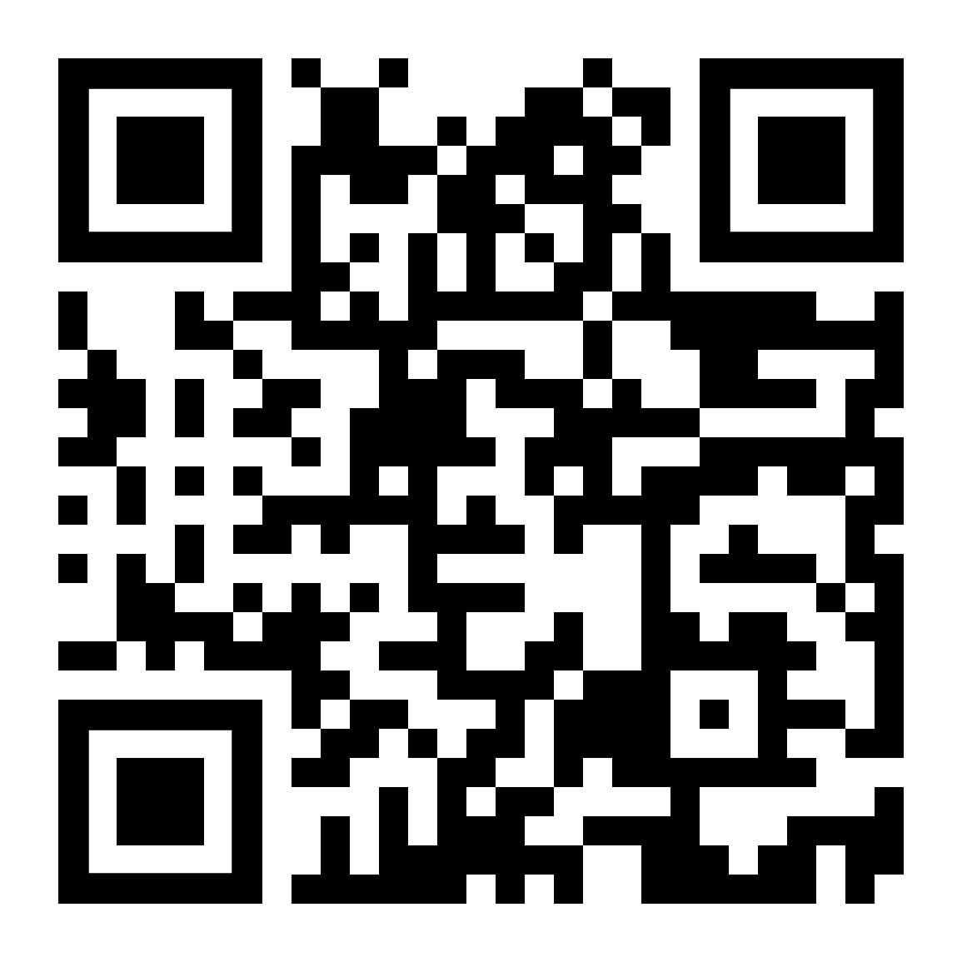
ICEG & Data standardization
Process derived from international standardization organisations and OSLO

Slide 10
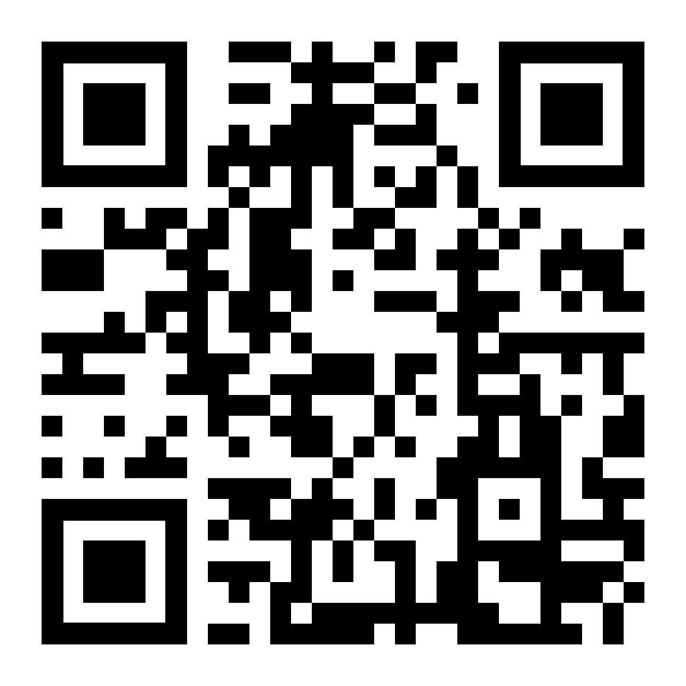
ICEG & Data standardization
Results:
Finalised
In the pipeline
URI
Public Services
Public Organizations
Hydrants
Buildings
Persons
Mobility: Timetable/Planning
Cables/Pipes (IMKL)

Slide 11
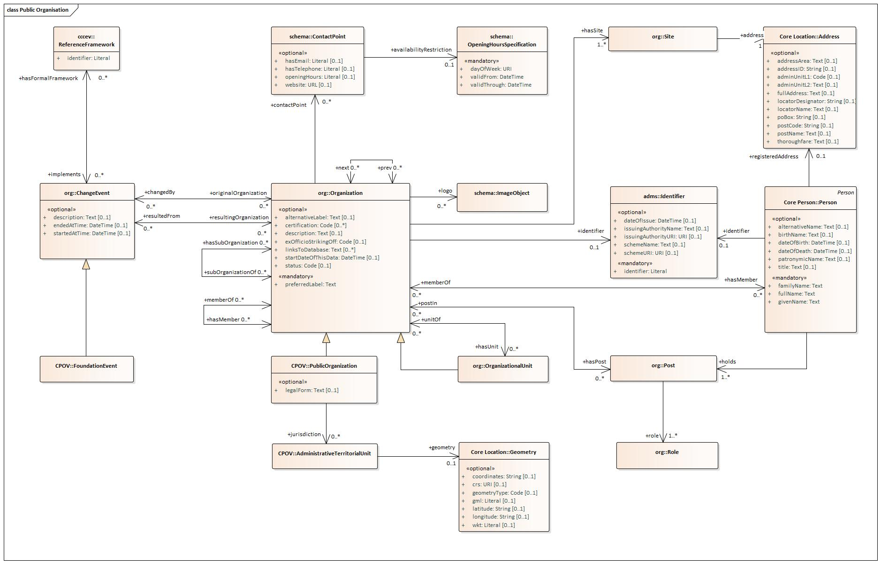
ICEG & Data standardization Public Organizations

Slide 12
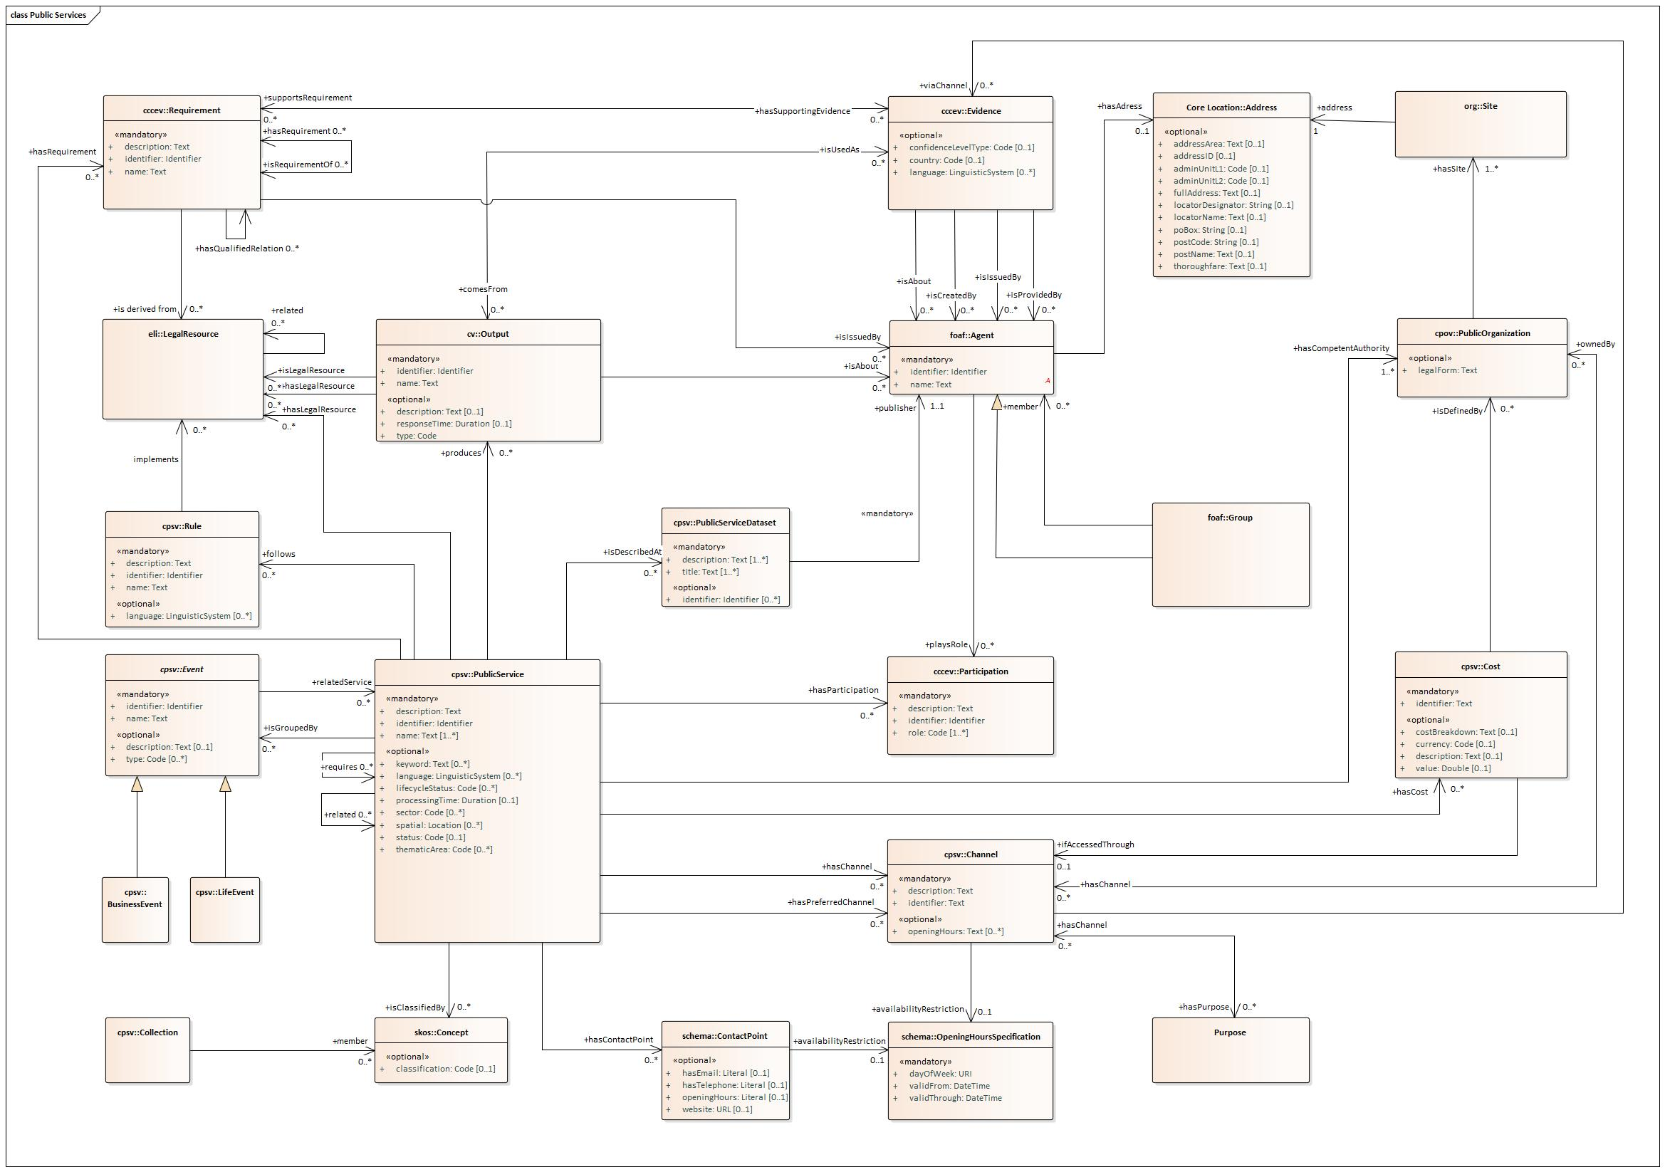
ICEG & Data standardization Public Services

